Slide 1
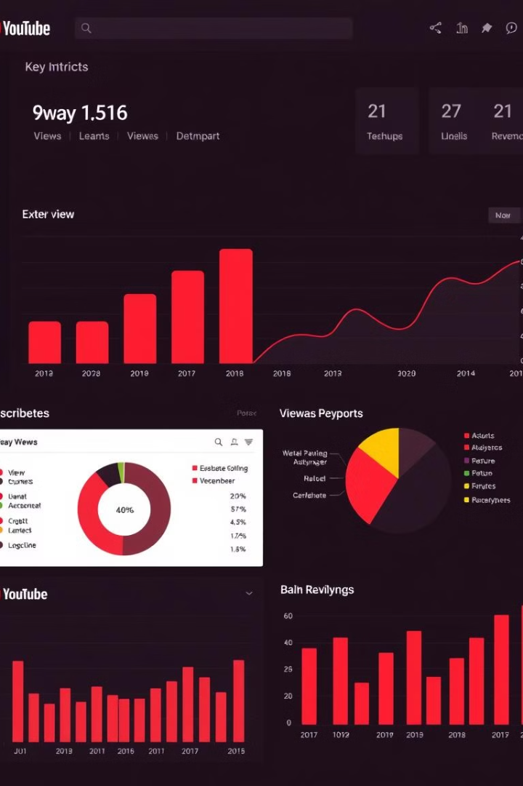
YouTube Analytics Dashboard
Welcome to our comprehensive YouTube Analytics Dashboard, a powerful tool that provides deep insights into the performance and growth of your YouTube channel. This presentation will guide you through the key metrics, visualizations, and strategies to maximize your YouTube success.

Slide 2
Data Sources and Methodology
Data Sources
Methodology
We gather information from the YouTube Analytics API, Google Trends, and demographic databases to give you a complete picture of your channel's performance.
Our team uses smart data analysis and comparison with industry benchmarks to provide clear, practical insights about your YouTube channel.

Slide 3
Key Metrics and Visualizations
Views and Engagement
Subscriber Growth
Track your video views, watch time, and engagement metrics to understand content performance and audience behavior.
Monitor your subscriber count, growth rate, and trends to identify effective subscriber acquisition strategies.
Revenue and Monetization
Channel Health
Assess your channel's overall health and performance using comprehensive metrics and benchmarking against industry standards.
Analyze your earnings, ad performance, and monetization potential to maximize your channel's revenue opportunities.

Slide 4
Ranking of Top YouTubers
Subscriber Leaders
View Leaders
Discover the top YouTube channels ranked by total subscribers, and learn from their content strategies and audience engagement tactics.
Analyze the most-viewed YouTube channels and understand the factors that contribute to their high view counts, such as content quality, promotion, and audience targeting.

Slide 5
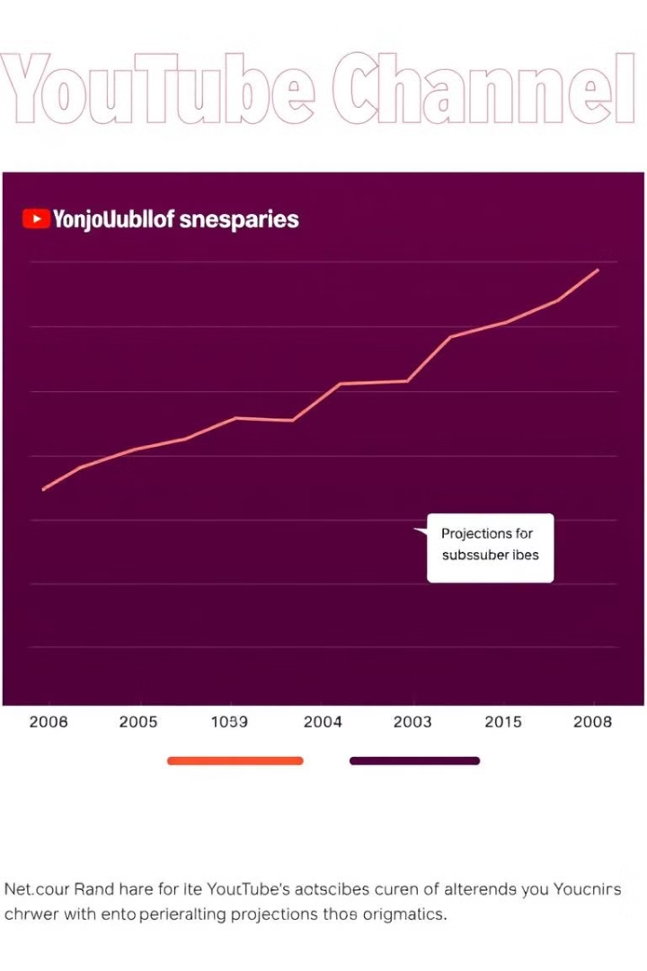
Channel Growth and Subscriber Trends
1
Channel Inception
Understand the early stages of your channel's growth and the factors that influenced your initial subscriber and view count.
2
Subscriber Milestones
Identify key subscriber milestones and the marketing strategies that drove your channel's subscriber growth over time.
3
Future Projections
Leverage data-driven forecasting to predict your channel's future growth and plan for long-term success.

Slide 6
Video Performance by Category and Title
Category Trends
Title Optimization
Analyze your video performance across different content categories to identify your strongest performing niches and opportunities for expansion.
Discover which video titles resonate best with your audience and learn how to craft captivating titles that drive views and engagement.

Slide 7



Insights on Uploads and Geographies
Upload Frequency
Geographic Insights
Understand the optimal upload cadence to keep your audience engaged and maximize your channel's growth.
Leverage your audience's geographic distribution to target content and promotion strategies for specific regions.

Slide 8
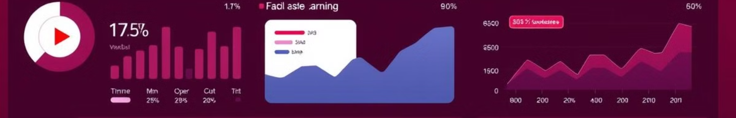
Earnings and Monetization Potential
$50K
$150K
Lowest Monthly Earnings
Highest Monthly Earnings
$500K
$1.8M
Lowest Yearly Earnings
Highest Yearly Earnings
Unlock the full revenue potential of your YouTube channel by optimizing your monetization strategies, ad placements, and audience targeting.

Slide 9

Conclusion
1
Key Takeaways
2
Next Steps
Leverage the insights from our comprehensive YouTube Analytics Dashboard to drive engagement, subscriber growth, and revenue for your channel.
Implement the strategies and best practices outlined in this presentation to take your YouTube channel to new heights of success.
3
Continued Support
4
Thank You
Our team is here to provide ongoing guidance and support as you navigate the ever-evolving YouTube landscape.
Thank you for your time and attention. Let's work together to unlock the full potential of your YouTube channel!

